Slide 1



PROJECT MANAGEMENT IN PRACTICE
Human Resource Management
Lecture No: 16 Week: 9
Vispi Shroff
vispi.shroff@ul.ie
Sub Heading
And Date

Slide 2

Recap
Organisational Behaviour Theory
Motivational Theories
Maslow’s Hierarchy
Herzberg’s Two Factor Theory
Influencing Behaviour
Employee Empowerment
Power
Covey’s 7 Habits

Slide 3
Today’s Topics & Learning Outcomes

Slide 4
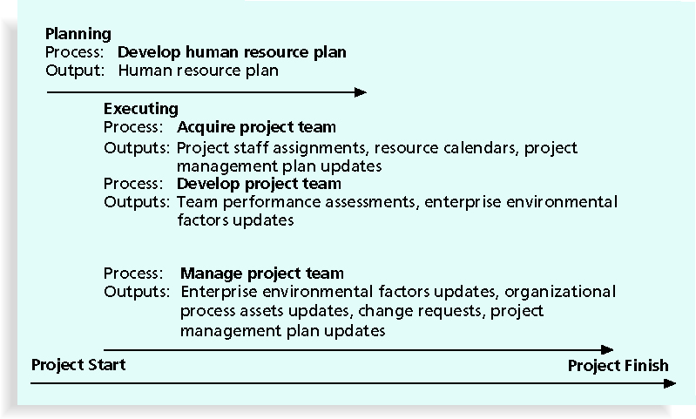

Slide 5
Developing a Human Resource Plan
- Involves identifying and documenting project roles, responsibilities, and reporting relationships
- Contents include:
- Project organizational charts
- Staffing management plan
- Responsibility assignment matrixes
- Resource histograms
- An example of an Organisational Chart?

Slide 6
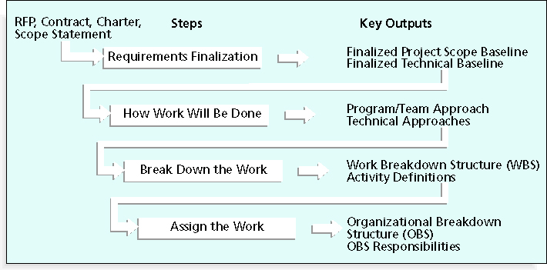
Work Definition & Assignment Process

Slide 7
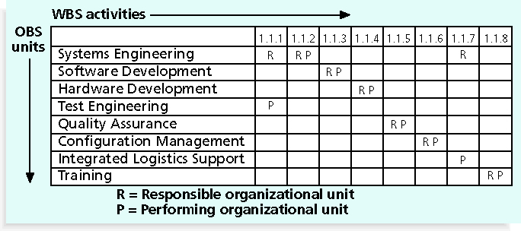
Responsibility Assignment Matrices
- A responsibility assignment matrix (RAM) is a matrix that maps the work of the project as described in the WBS to the people responsible for performing the work as described in the OBS
- Can be created in different ways to meet unique project needs

Slide 8
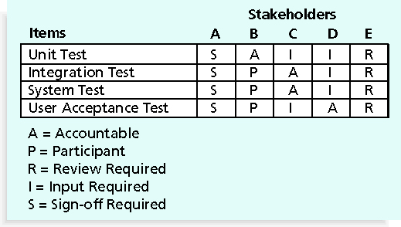
RAM showing Stakeholder Roles

Slide 9
Staff Management Plans and Resource Histograms
- A staffing management plan describes when and how people will be added to and taken off the project team
- A resource histogram is a column chart that shows the number of resources assigned to a project over time

Slide 10
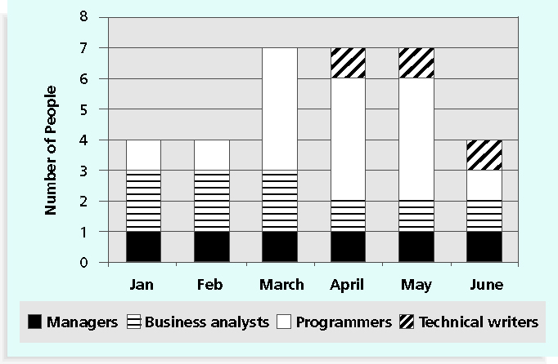
Sample Resource Histogram

Slide 11
Acquiring the Project Team
- Acquiring qualified people for teams is crucial
- The project manager who is the smartest person on the team has done a poor job of recruiting!
- It’s important to assign the appropriate type and number of people to work on projects at the appropriate times

Slide 12
Resource Loading & Levelling
- Resource loading refers to the amount of individual resources an existing schedule requires during specific time periods
- Helps project managers develop a general understanding of the demands a project will make on the organization’s resources and individual people’s schedules
Overallocation means that more resources than are available are assigned to perform work at a given time.
- Resource leveling is a technique for resolving resource conflicts by delaying tasks
- The main purpose of resource leveling is to create a smoother distribution of resource usage and reduce overallocation.

Slide 13
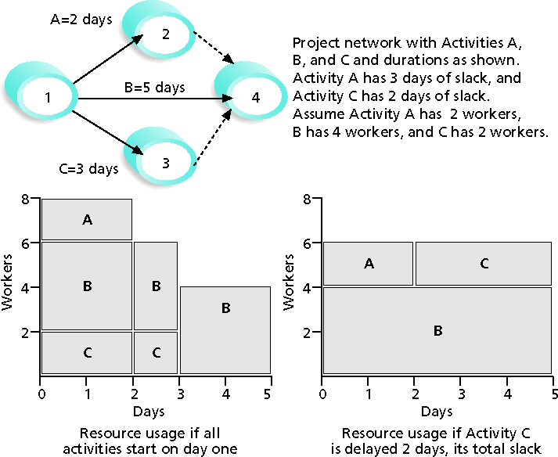
Resource Levelling Example

Slide 14
Benefits of Resource Levelling
- When resources are used on a more constant basis, they require less management
- It may enable project managers to use a just-in-time inventory type of policy for using subcontractors or other expensive resources
- It results in fewer problems for project personnel and accounting department
- It often improves morale

Slide 15
Developing the Project Team
- The main goal of team development is to help people work together more effectively to improve project performance
It takes teamwork to successfully complete most projects
Teams take time to develop , and go through the following stages
Forming
Storming
Norming
Performing
Adjourning

Slide 16
Reward and Recognition Systems
- Team-based reward and recognition systems can promote teamwork
- Focus on rewarding teams for achieving specific goals
- Allow time for team members to mentor and help each other to meet project goals and develop human resources

Slide 17
Managing the Project Team
- Project managers must lead their teams in performing various project activities
- After assessing team performance and related information, the project manager must decide:
- If changes should be requested to the project
- If corrective or preventive actions should be recommended
If updates are needed to the project management plan or organizational process assets
Tools and techniques include observation and conversation, project performance appraisals, conflict management, issue logs and interpersonal skills

Slide 18
Five Dysfunctions of a Team
- Patrick Lencioni, author of several books on teams, says that “Teamwork remains the one sustainable competitive advantage that has been largely untapped”*
- The five dysfunctions of teams are:
Absence of trust
Fear of conflict
Lack of commitment
Avoidance of accountability
Inattention to results
http://www.youtube.com/watch?v=6dRKa700RaQ

Slide 19
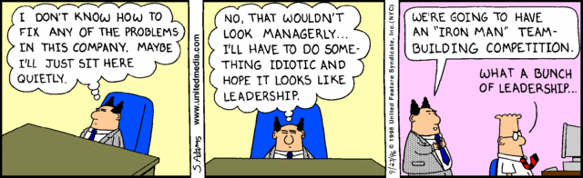
Any Thoughts, Questions, Ideas?

Slide 20
Reading Materials for the Week
Schwalbe, K., 2007. Information Technology Project Management 5th ed., United States of America: Thomson Course Technology. Chapter 9
PMBOK Guide, Chapter 9

Slide 21
Conclusions
- Project human resource management includes the processes required to make the most effective use of the people involved with a project
- Main processes include:
- Develop human resource plan
- Acquire project team
- Develop project team
- Manage project team

Slide 22
References
- Schwalbe, K., 2007. Information Technology Project Management 5th ed., United States of America: Thomson Course Technology. Chapter 9
PMBOK Guide, Chapter 9
Lencioni, P., 2002. The Five Dysfunctions of a Team 1st ed., Jossey-Bass.

